Slide 1


Grid-Forming PV + BESS for Deep Protein Processing LLC
PV 3.6 MWp + BESS 7.5 MW / 15.05 MWh · Cherkasy region · 35 kV connection
Team №2 B-2 Spirit from LPNU
Notes:
1

Slide 2





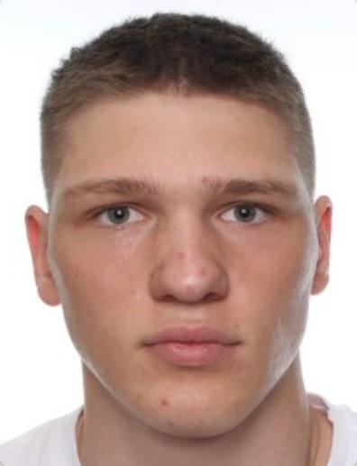
TEAM
Serhii Melnykov (29 y.o.)
Origin: Lviv, Lviv district, Ukraine
Education: LPNU, IKTE, Ph.D. at Network Telecommunication engineering
Role: Mentor
Focus: Help to achieve those high results.
Andrian Tykhyi (19 y.o.)
Origin: Drohobych, Lviv district, Ukraine
Education: LPNU, IKTE, 3rd year student of Electronics engineering
Role: Power Lead
Focus: System architecture for hybrid microgrid ware layout
Andrii Dotsenko (20 y.o.)
Origin: Zolotonosha, Cherkasy district, Ukraine
Education: LPNU, IKTE, 3rd year student of Electronics engineering
Role: Finance Lead
Focus: Twenty-year discounted cash flow modeling.
Volodimir Andriychuk (20 y.o.)
Origin: Kolomyia, Ivano-Frankivsk district, Ukraine
Education: LPNU, IKTE, 3rd year student of Electronics engineering
Role: HV Engineer
Focus: High-voltage substation layout at 35 kV.
ware layout
Arsenii Fediuk (19 y.o.)
Origin: Kolomyia, Ivano-Frankivsk district, Ukraine
Education: LPNU, IKTE, 3rd year student of Electronics engineering
Role: EMS Lead
Focus: Linear programming dispatch model design.

Slide 3
PROBLEM STATEMENT
The client has a 15 MW connection and a 20 MW appetite
15 MW
20 MW
5 MW
5 MW
grid connection limit at 35 kV
peak plant load
critical load that must never stop
existing CHP, the only backup today
At the 20 MW peak the import is 20 − 5 = 15 MW: exactly at the limit, with no headroom and no backup if the CHP trips.
Brief: Huawei PV + BESS, on-grid and off-grid, day-ahead arbitrage and microgrid scenarios, with a commercial case for renewables.
No load profile was given, so we built our own: 11 MW at night, 17 MW by day, 20 MW peaks at 10–12 and 14–16 h.

Slide 4
SOLUTION
3.6 MWp PV and a 7.5 MW / 15.05 MWh grid-forming BESS on two separate 35 kV transformer stations
SOLAR
STORAGE
GRID LINK
CONTROL
3.6 MWp
15.05 MWh
9 MVA + 3 MVA
2 layers
10 × SUN2000-330KTL-H1, 3.0 MW AC, DC/AC 1.2
3 × LUNA2000-5015-2S (3 × 2.5 MW), 36 × PCS 213KTL-H0, liquid-cooled LFP
JUPITER-9000K-H1 (BESS only), STS-3000K (PV only), DTS
SPPC2000-MGCC, SPMS and our price optimiser
Equipment €67,000
Equipment €1,707,600
Equipment €270,500
Equipment €74,000
Virtual grid capacity
N-1 critical supply
Island and black start
BESS holds import at 14.5 MW, so a 20 MW peak fits a 15 MW line
Any two of three containers give 5.0 MW for the critical load
Grid-forming transfer in ≤ 200 ms; MGCC sheds non-critical load
CAPEX ≈ €3.88 M = Huawei equipment €2.12 M + PV field ≈ €0.90 M + works ≈ €0.19 M + 20% contingency €0.64 M + software €0.03 M. Build time: 12 months.

Slide 5
SOLUTION: EQUIPMENT & CAPEX
Item | Qty | Total, EUR
LUNA2000-5015-2S container (5.015 MWh, liquid-cooled LFP) | 3 | 1,470,000
LUNA2000-213KTL-H0 PCS | 36 | 237,600
JUPITER-9000K-H1 STS, 9 MVA, 35 kV (BESS only) | 1 | 153,000
STS-3000K, 3 MVA, 35 kV (PV only) | 1 | 105,000
SUN2000-330KTL-H1 PV inverter | 10 | 67,000
SPPC2000-MGCC plant and microgrid controller | 1 | 20,000
SPMS local station server, HMI | 1 | 54,000
DTS auxiliary transformer | 1 | 12,500
Huawei equipment subtotal (DAP Ukraine) |  | 2,119,100
PV modules and structures, 3.6 MWp (our estimate) | lot | ≈ 900,000
35 kV bays, civil works, fire wall, load-shedding upgrade (estimate) | lot | ≈ 188,000
Contingency 20% |  | ≈ 641,400
Price optimiser software, one-off (estimate) |  | 30,000
Total CAPEX |  | ≈ 3.88 M

Slide 6
WHY THREE CONTAINERS
Three containers keep the 5 MW critical load with one container out
Configuration | PCS | Apparent power, rated / long-term, MVA | Active, MW | Critical 5 MW at PF 0.9 (5.56 MVA)
2 containers | 24 | 5.11 / 5.67 | 5.0 | No: below the requirement at rated power; nothing left if one container fails
3 containers | 36 | 7.67 / 8.51 | 7.5 | Yes, with 38% margin at rated power
3 containers, one out | 24 | 5.11 / 5.67 | 5.0 | Yes, only at the long-term maximum (2% margin) or with the CHP running
N-1 at unity PF
Reactive power
Double fault
1 container: 0 MW with one out; 2 containers: 2.5 MW; 3 containers: 5.0 MW from any two
5 MW at PF 0.9 = 5.56 MVA incl. 2.42 Mvar; 36 PCS reach 8.51 MVA, under the 9 MVA STS
CHP and a container out together: the MGCC may shed part of the critical load

Slide 7
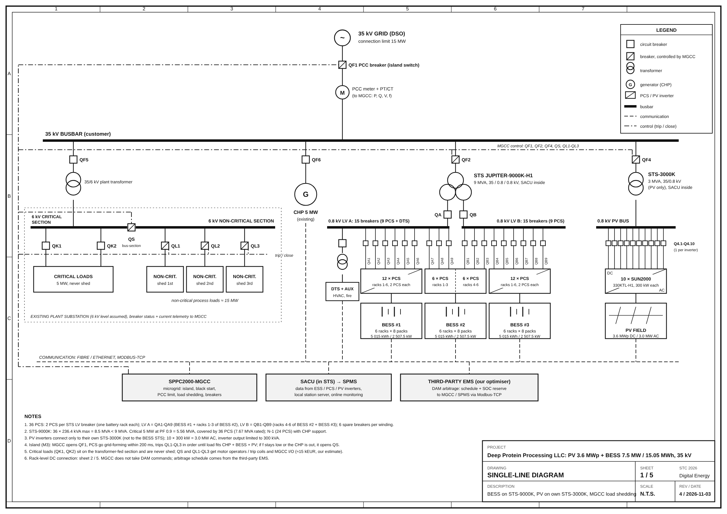
Single-line diagram: BESS on STS-9000K, PV on its own STS-3000K
Separate transformers
PV inverters never share the BESS transformer; STS-3000K is the smallest Huawei unit for 3.0 MW AC
Balanced windings
LV A: 18 PCS (BESS1 + racks 1–3 of BESS2); LV B: 18 PCS (racks 4–6 of BESS2 + BESS3); 3.83 MW each
Inside the rating
7.5 MW BESS (8.51 MVA at long-term max) on a 9 MVA STS; one breaker per rack, 6 spare per winding

Slide 8
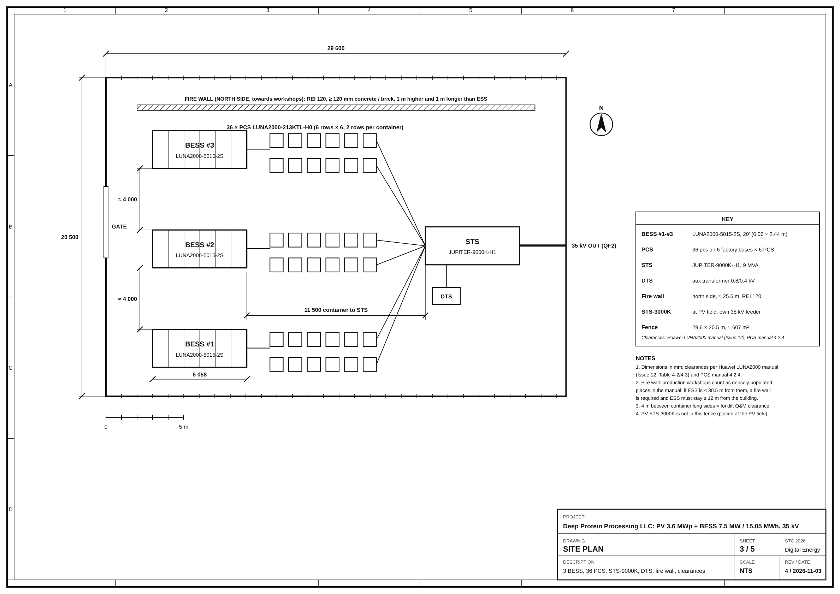
Site layout: 607 m² fenced BESS area, fire wall on the north side
29.6 × 20.5 m fence
About 607 m² without the PV field; the STS-3000K stands at the PV field, outside the fence
Distances from the manuals
Containers 11.5 m from the STS, 4 m between long sides for the forklift; 3 m to other buildings and roads
Safety first
2-hour fire wall on the north side only; ESS ≥ 12 m from workshops; wall can be dropped if the survey shows > 30.5 m

Slide 9
PV PLANT
3.6 MWp on its own STS-3000K: the cheapest energy the plant can add
3.6 MWp
4,157 MWh
€362 k
3.0 y
DC; 3.0 MW AC, DC/AC 1.2, 10 × SUN2000-330KTL-H1
per year (1,154.6 kWh/kW, PVGIS-5, Cherkasy)
per year: €246 k at the DAM price + €116 k avoided tariff
simple payback with tariff; 4.4 y for energy only
PV CAPEX ≈ €1,072 k
Sized to the STS-3000K
PV + BESS synergy
Modules and structures 900 + inverters 67 + STS-3000K 105 (our estimate, ≈ €250/kW DC)
A larger plant needs a bigger transformer and more land; field ≈ 3.6–4.3 ha (our estimate)
From spring to autumn PV charges the BESS in the midday price dip; PV adds ≈ €1.66 M NPV

Slide 10
OPERATING SCENARIOS
Scenario | What the plant does | Result
DAM arbitrage | Charges from PV and in the midday price dip, discharges in the evening peak (winter: charges at night or by day) | €878 k/yr at 10% SOC reserve (€965 k at 0%)
PV self-consumption | 4,157 MWh/yr of PV replaces grid import and charges the BESS | €362 k/yr (DAM price €246 k + avoided tariff €116 k)
Peak shaving above 15 MW | BESS covers the excess when the CHP is out or PV drops; import capped at 14.5 MW | Up to 5 MW for ≈ 2.7 h (13.5 MWh usable)
Critical-load backup | Dynamic SOC reserve: 10%, raised to 30% when the CHP is down | 5 MW for ≈ 18 min (10%) or ≈ 54 min (30%)
Island and black start | MGCC switches in ≤ 200 ms; BESS forms the grid, CHP and PV work in parallel | Critical 5 MW kept; PV curtailed by P(f)
Ancillary services | Grid-forming PCS can reserve part of the power for frequency regulation | Upside only; Ukrenergo rates not found, no figure claimed

Slide 11
EMS
Two-layer EMS: daily price optimisation above real-time protection
Layer 2: our optimiser
Layer 1: SPPC2000-MGCC
Data: SACU → SPMS
Once a day after the DAM results: LP over 24 hourly prices → hourly power schedule + SOC reserve, sent over Modbus-TCP
ms to s: breakers, 15 MW import guard (virtual 14.5 MW), load shedding, island; always has the last word
SACU in each JUPITER collects data from containers, PCS and PV inverters; SPMS gives online monitoring
EMS option | Gross BESS margin, k EUR/yr | Payback, base / stress
A. Fixed windows (minimum): seasonal schedule + import guard | 830 | 3.6 / 4.6 years
B. Price-based optimisation: A + daily optimiser (+€48 k/yr, ≈ 6%) | 878 | 3.4 / 4.4 years
C. Microgrid (target): B + island, black start, load shedding, dynamic reserve | 878 | 3.4 / 4.4 years

Slide 12
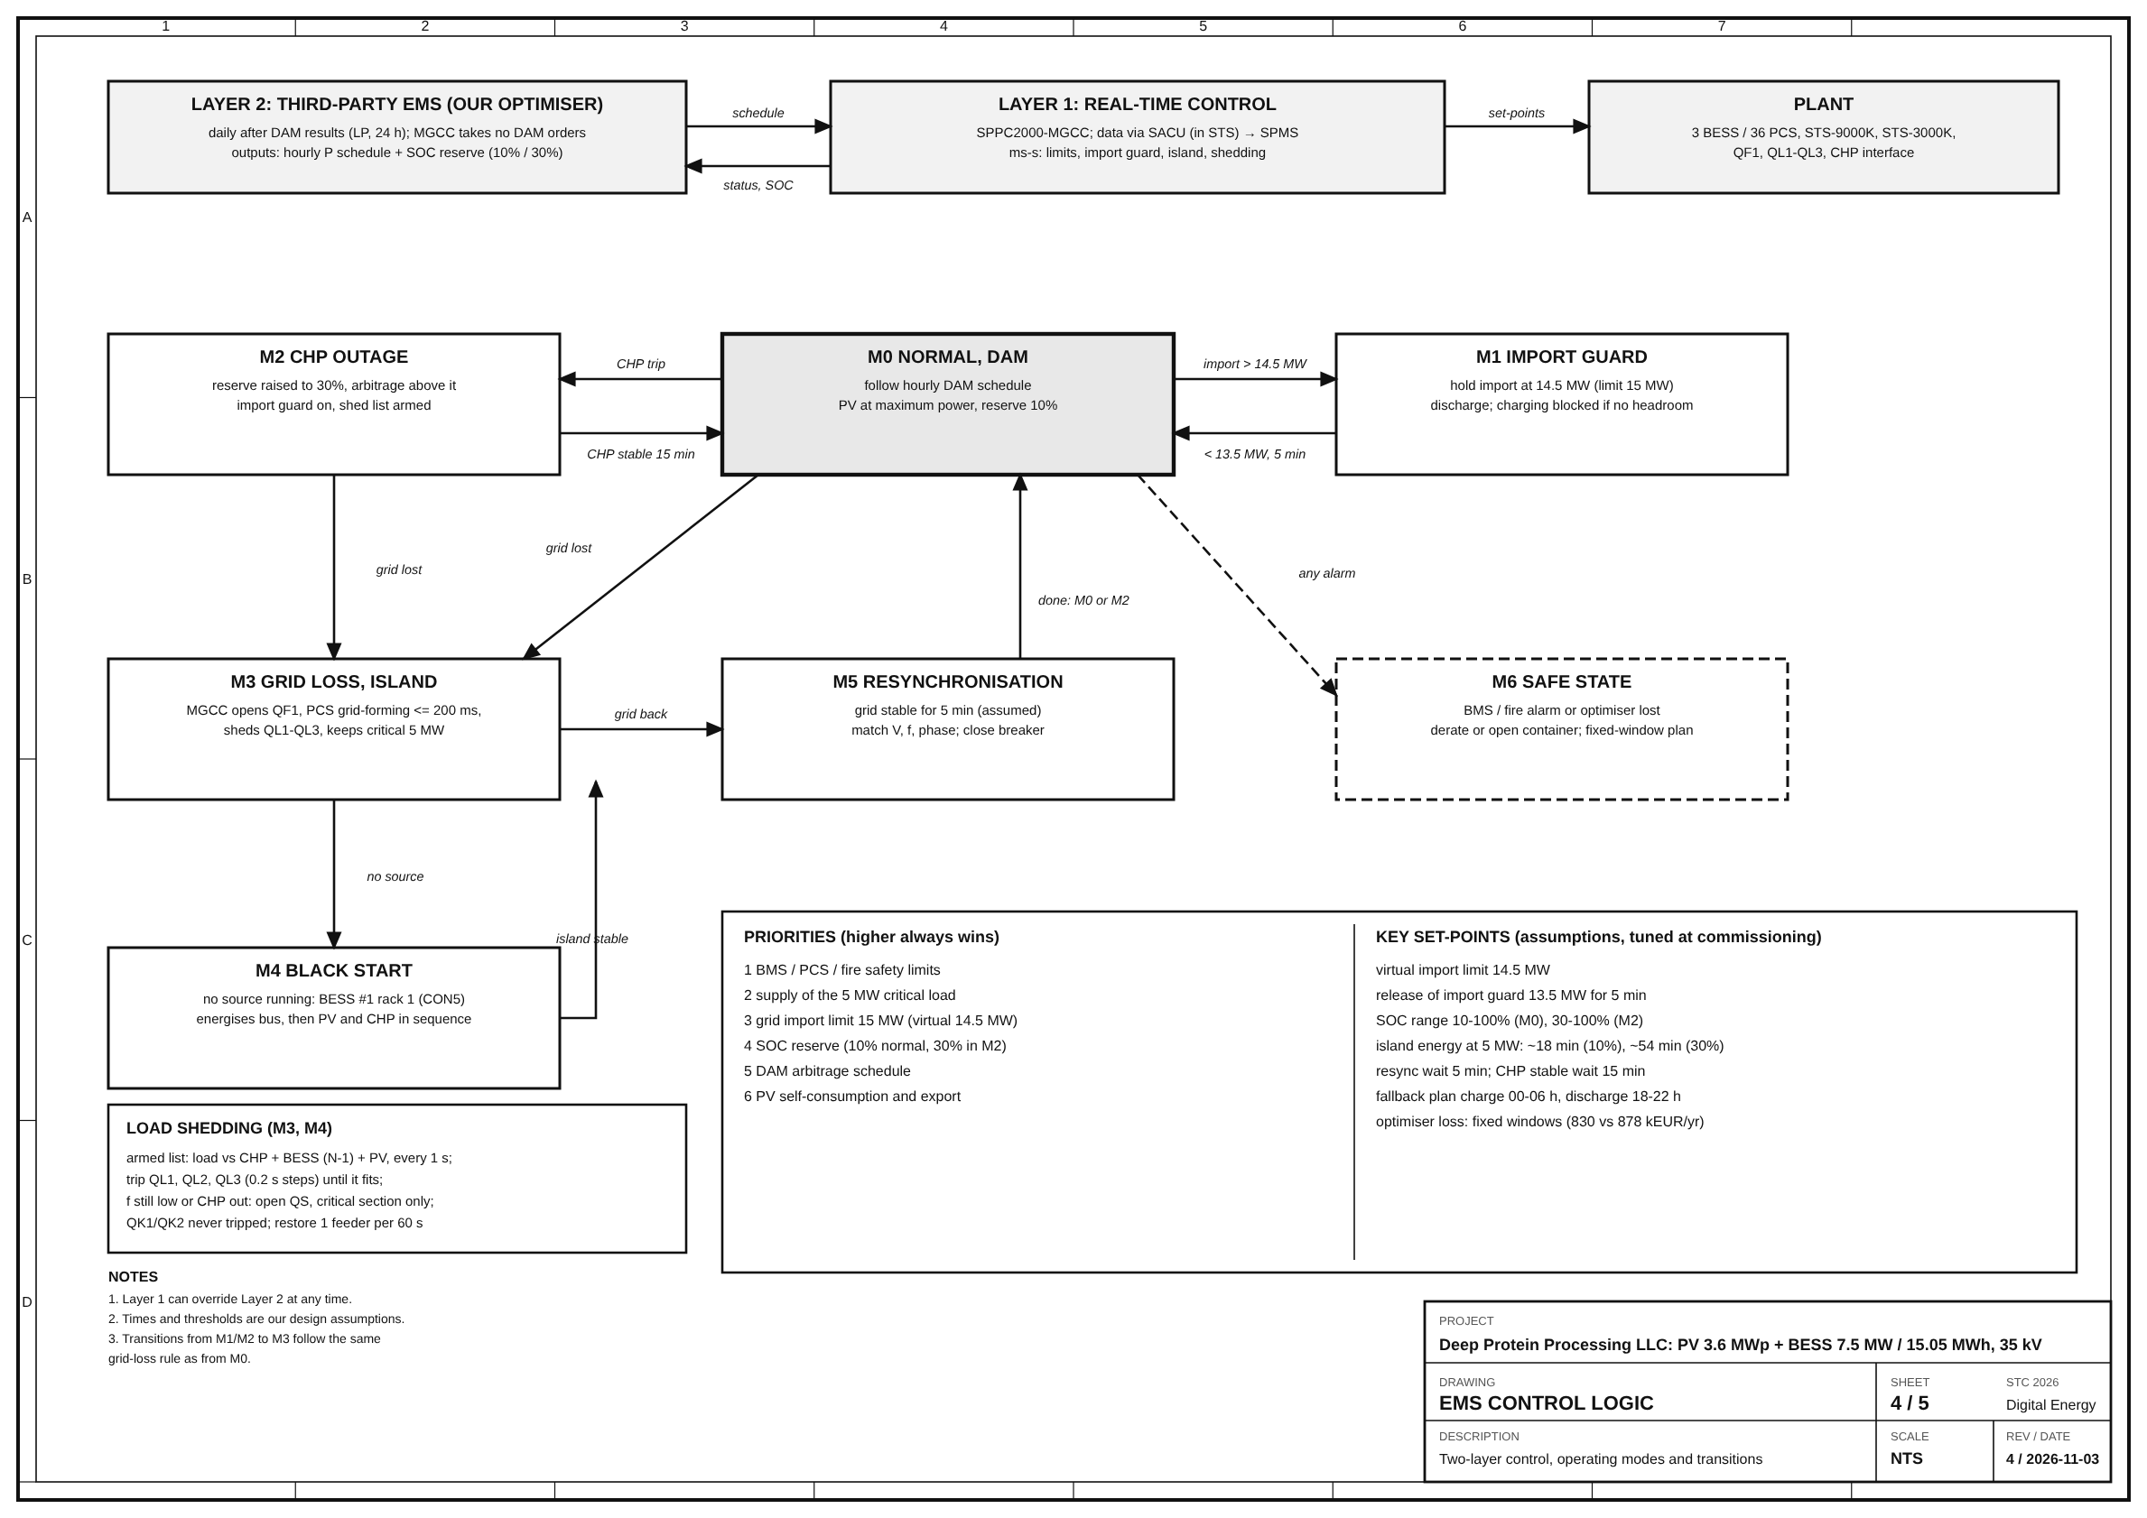
EMS control logic: seven operating modes, clear priorities
Two layers
The optimiser plans once a day; the MGCC protects in ms to s and can override it
Priority order
BMS/PCS/fire → 5 MW critical load → 15 MW import limit → SOC reserve → DAM arbitrage → PV
Key set-points
Import guard 14.5 MW (release < 13.5 MW for 5 min); reserve 10%, 30% if CHP is out; resync after 5 min

Slide 13
ISLAND MODE
The MGCC sheds non-critical load; the 5 MW critical section never trips
Split 6 kV bus
Grid lost
Critical section 5 MW (QK1, QK2): never shed. Non-critical ≈ 15 MW in three groups QL1–QL3 behind the bus-section breaker QS
MGCC opens QF1, PCS go grid-forming in ≤ 200 ms; QL1 → QL2 → QL3 trip in 0.2 s steps until the load fits CHP + BESS (N-1) + PV; if f keeps falling or the CHP is out, QS opens
Example: 20 MW peak, CHP running
Without the CHP
Sources 5 + 5.0 + ≈ 1.5 MW PV ≈ 11.5 MW: QL1 and QL2 open, ≈ 10 MW stays on, incl. the full 5 MW critical load
BESS alone carries the critical 5 MW for ≈ 18 min (10% reserve) or ≈ 54 min (30%); after resync feeders return one per 60 s
To confirm: the plant’s feeder list and CHP operation in parallel with a grid-forming BESS.

Slide 14
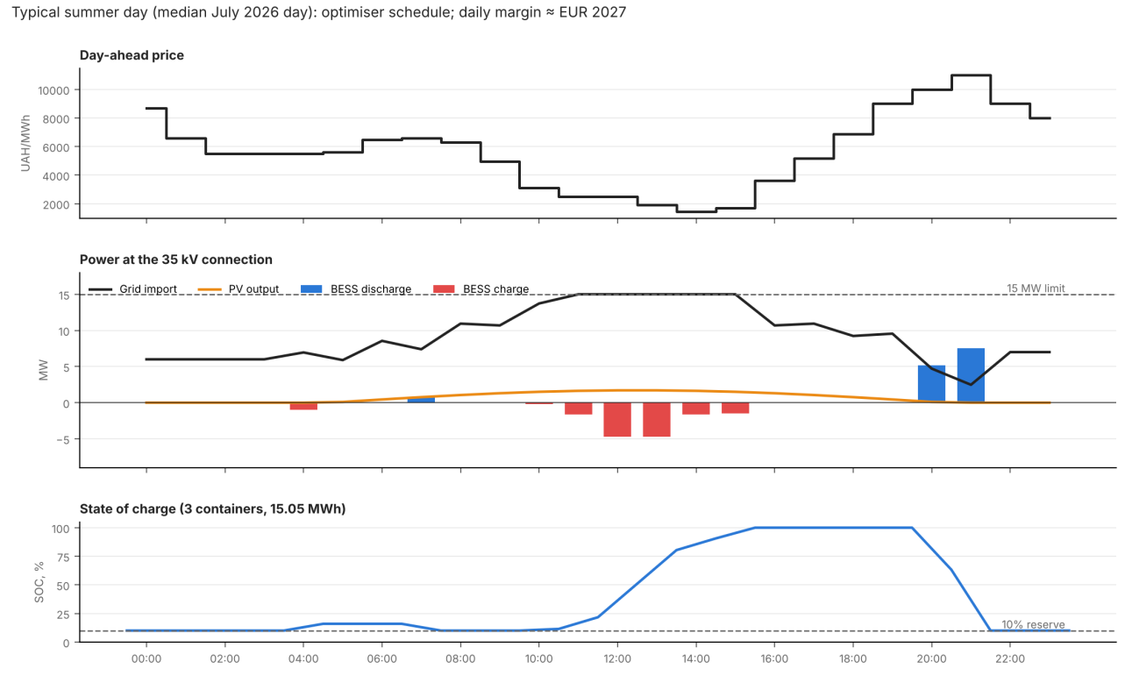
A typical July day: charge in the midday dip, discharge in the evening peak
Charge
≈ 12:00–15:00, only within the headroom under 15 MW: grid import sits exactly at the limit
Discharge
20:00–22:00 price peak; SOC runs from the 10% reserve to 100%; daily margin ≈ €2.0 k
Cost of the limit
Headroom is only 0.2–1.6 MW at 10–12 h and 14–16 h; the limit costs ≈ €16 k/year

Slide 15
RESULTS
€1,157 k net benefit in year 1 and a payback of 3.4 years
Year-1 cash flow, k EUR
3.4 y
28.0%
Simple payback; stress case 4.4 y
20-year IRR; stress case 21.2%
€4.96 M
20 MW
NPV at 10%; stress case €3.02 M
peak served on a 15 MW connection
Stress case = BESS margin × 0.7; every sensitivity case keeps a positive NPV. Costs and fade = auxiliary −33, O&M and software −42, degradation −8.

Slide 16
SIZING
Three containers: the smallest N-1 size with the best payback and IRR
Size | CAPEX, EUR M | BESS margin, k EUR/yr | Net year 1, k EUR | Payback base / stress, y | IRR base / stress, % | NPV 10% base / stress, EUR M | Critical 5 MW, one container out
1 container | 2.33 | 297 | 621 | 3.8 / 4.5 | 25.1 / 21.3 | 2.54 / 1.88 | No (0 MW)
2 containers | 3.10 | 593 | 894 | 3.5 / 4.4 | 27.1 / 21.4 | 3.78 / 2.47 | No (2.5 MW)
3 containers (chosen) | 3.88 | 878 | 1,157 | 3.4 / 4.4 | 28.0 / 21.2 | 4.96 / 3.02 | Yes (5.0 MW)
4 containers | 4.78 | 1,142 | 1,398 | 3.5 / 4.6 | 27.4 / 20.1 | 5.89 / 3.34 | Yes (7.5 MW)
5 containers | 5.54 | 1,384 | 1,618 | 3.5 / 4.7 | 27.4 / 19.7 | 6.82 / 3.71 | Yes (10.0 MW)
6 containers | 6.32 | 1,615 | 1,828 | 3.5 / 4.8 | 27.1 / 19.2 | 7.64 / 4.00 | Yes (12.5 MW)
Why not more
Why not fewer
Market
4 containers = 10 MW > 9 MVA STS: a second transformer and bay; margin per container falls 297 → 269 k/yr; IRR 28.0% → 27.1%
One container gives no security; two give exactly 5.0 MW and only 2.5 MW if one fails
10 MW / 20 MWh would start to move day-ahead prices and weaken the price-taker assumption

Slide 17
SENSITIVITY
Case | Year-1 net, k EUR | Payback | IRR, 20 y | NPV at 10%
Base case, 15 MW import cap | 1,157 | 3.4 y | 28.0% | €4.96 M
Stress: BESS margin × 0.7 | 896 | 4.4 y | 21.2% | €3.02 M
BESS margin × 0.85 | 1,027 | 3.9 y | 24.6% | €3.99 M
BESS margin × 1.15 | 1,288 | 3.1 y | 31.4% | €5.94 M
CAPEX +10% | 1,157 | 3.8 y | 25.3% | €4.58 M
CAPEX −10% | 1,157 | 3.1 y | 31.4% | €5.35 M
30% SOC reserve held all year | 976 | 4.1 y | 23.3% | €3.60 M
PV annual yield −10% | 1,121 | 3.5 y | 27.0% | €4.67 M
PV CAPEX €300/kW DC | 1,157 | 3.6 y | 26.4% | €4.75 M
Model basis
Our estimates, not given data
Hourly DAM prices (Jan, Apr, Jul, Oct 2026), LP dispatch with the 15 MW import limit, 88% cycle efficiency, one cycle per day, UAH 51.5/EUR, 20 years, 10% discount, O&M 1.5% of Huawei CAPEX ≈ €32 k/yr
Load profile, PV cost (€250/kW), works cost and the 12-month schedule are listed in the report; a 30% reserve all year would cost €182 k/yr

Slide 18
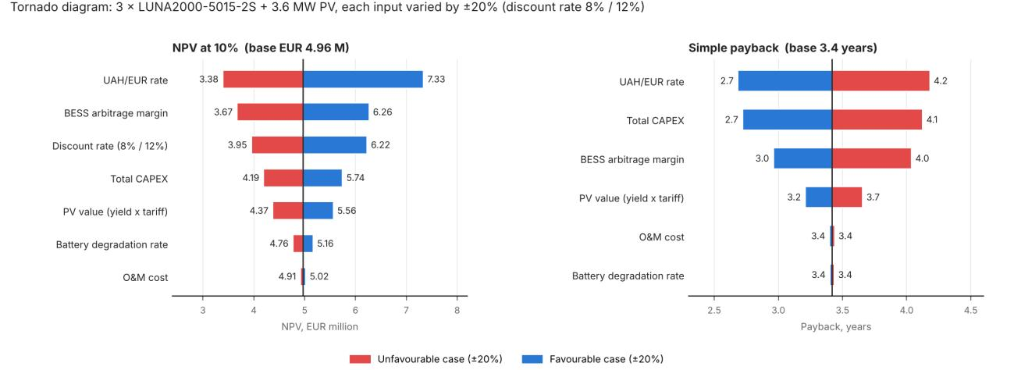
Exchange rate, BESS margin and CAPEX matter most
Still positive
Exchange rate first
Little effect
Each input moved ±20%: lowest NPV €3.38 M, longest payback 4.2 years
Degradation and O&M hardly move the result; the discount rate affects only NPV
All revenue is in hryvnia and all CAPEX in euro

Slide 19
COMPETITORS
Other solutions earn less or protect less than our PV + BESS plant
Alternative | Drawback | Our answer
Grid reinforcement to 20 MW | Cost and lead time set by the operator; no market revenue | Virtual grid capacity: BESS holds import at 14.5 MW, nothing to reinforce
Second gas CHP unit | Fuel cost and emissions; no arbitrage or PV revenue | No fuel: PV + BESS net €1,157 k in year 1
BESS without PV | CAPEX ≈ €2.56 M, NPV ≈ €3.30 M, IRR ≈ 28.7% | PV adds ≈ €1.66 M NPV and pays back alone in 3.0 years
Two containers | Exactly 5.0 MW, only 2.5 MW if one fails; NPV €3.78 M | Three containers: N-1 secure, NPV €4.96 M
Four containers | Second BESS STS and third bay; CAPEX €4.78 M; IRR 27.4% (stress 20.1%) | Three is the balance point
Fixed-window EMS | €830 k/yr instead of €878 k/yr; no island mode or black start | Microgrid EMS: price-optimised, island ≤ 200 ms, black start

Slide 20
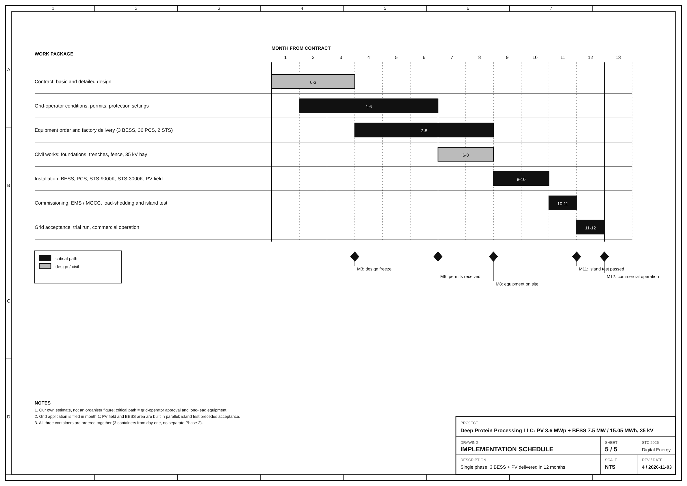
Delivery: 12 months from contract to commercial operation
Critical path
Our estimate: grid-operator approval and long-lead equipment drive the 12 months; application filed in month 1
Fast on site
Factory-built containers and STS; PV field and BESS area are built in parallel
Island test before acceptance
All three containers and both transformer stations are ordered together: no second phase

Slide 21
INNOVATIONS
What is special in our solution
Virtual grid capacity
N-1 critical supply
Automatic load shedding
Dynamic reserve
20 MW peak on a 15 MW connection; no grid reinforcement
Lose any one of three containers; 5.0 MW stays
Armed list updated every second; feeders trip in 0.2 s steps
10% normally, 30% when the CHP is out; a priced decision
Degradation-aware dispatch
Island and black start
Joint PV + BESS optimiser
Multi-layer safety
A cycle only if the spread beats the ≈ €227 wear cost
Grid-forming PCS, ≤ 200 ms; start from rack 1 of BESS1
Separate transformers, one controller, one optimiser
Gas suppression, sprinkler, detectors, liquid cooling, fire wall

Slide 22
CALL TO ACTION
Approve the project: €3.88 M CAPEX, 3.4-year payback, 12 months to operation
Prospects and next steps
Why choose B-2 Spirit
M0–M3
1. One plant, three jobs: arbitrage, a 20 MW peak on a W line, N-1 backup for 5 MW
2. Stress-tested: payback is 4.4 years and NPV €3.02 M even with the battery margin cut by 30%
3. Every number traced to Huawei manuals and organiser data; assumptions are listed
4. Grid-forming island in ≤ 200 ms and black start for the critical load
Design and grid-operator filing
M3–M8
Huawei delivery and civil works
M8–M11
Installation, commissioning and island test
M11–
M12
Acceptance and commercial operation

Slide 23

2026 Student
Tech Challenge
by Huawei Ukraine
Thank you! Team B-2 Spirit is ready for your questions.

